Slide 1
COSC 222 Data Structures
Yves Lucet

Slide 2
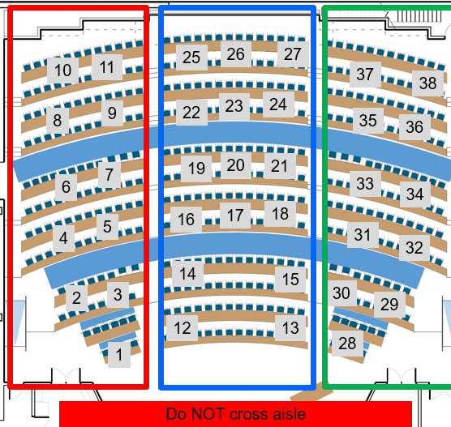
Team build & critic
Do not forget to assign a TIMEKEEPER
[10 marks] Answer the questions on your poster
write clearly
Take picture and post it on Canvas as group assignment tMAT0
[4 marks] Rotate posters on each aisle (left, centre, right); do NOT cross aisle. Critic 4 posters. Make a list of any error, bug, omission; is complexity correct?
The full team has to agree on the justification
Upload your poster to tMAT0
Be quick! We have to start even if you haven’t finished writing your poster!
Include the list of team members present today
On your poster
DO NOT USE INTERNET except to submit tMAT
30’
4’
Per
poster
Notes:
15’ post-mortem
10’ quiz
30’ write poster
16’ read 4 posters
Total = 71’ [only read 3 posters if 3rd poster is after 1:40]

Slide 3
Change from Tuesday
2 assignments
tMAT1 – Answer upload a picture of your poster with your answer
tMAT1 – Critics for each critic, upload the poster you are criticizing, and your critic on top

Slide 4
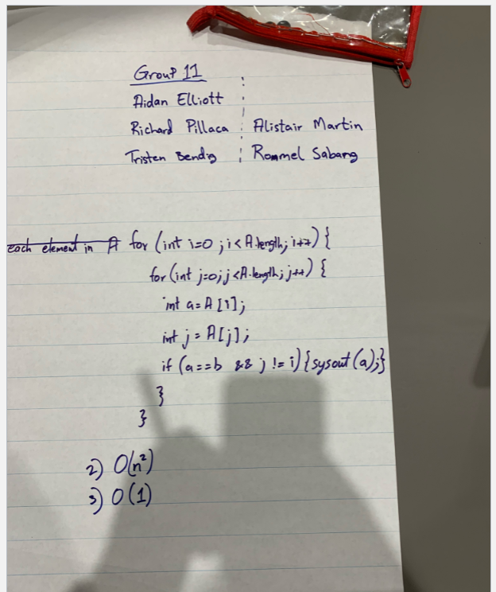
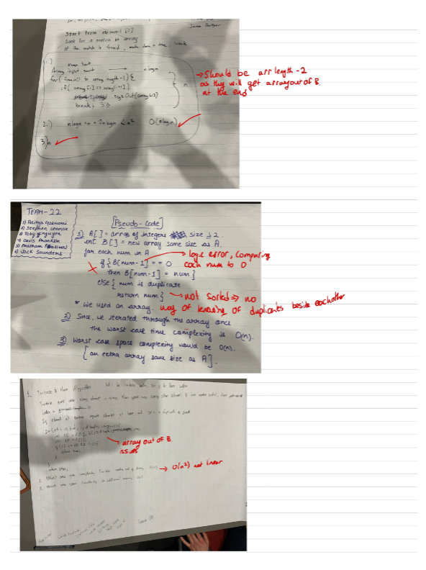
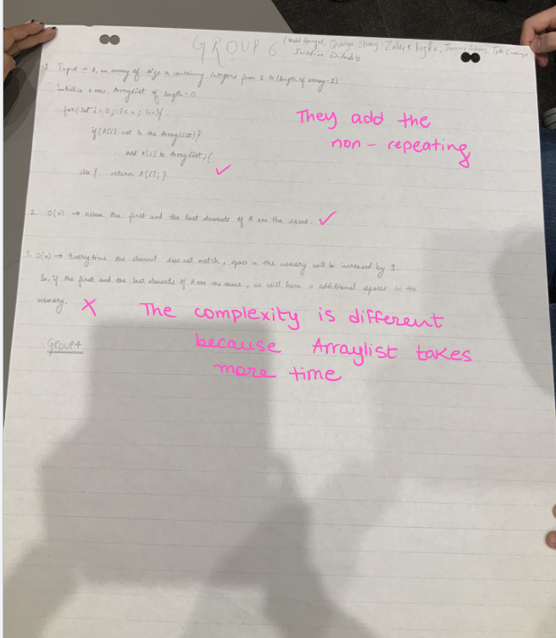

Slide 5
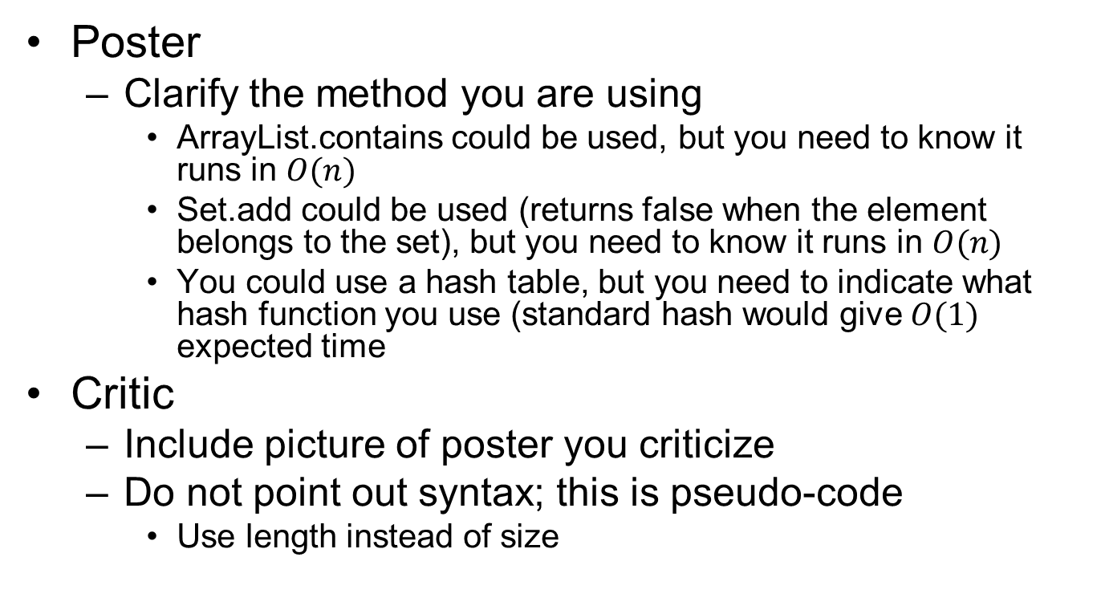
Feedback
Poster
Clarify the method you are using
ArrayList.contains could be used, but you need to know it runs in $O(n)$
Set.add could be used (returns false when the element belongs to the set), but you need to know it runs in $O(n)$
You could use a hash table, but you need to indicate what hash function you use (standard hash would give $O(1)$ expected time
Critic
Include picture of poster you criticize
Do not point out syntax; this is pseudo-code
Use length instead of size

Slide 6
Team build & critic
Do not forget to assign a TIMEKEEPER
[10 marks] Answer the questions on your poster
write clearly
Take picture and post it on Canvas as group assignment tMAT1 - Answer
[4 marks] Rotate posters on each aisle (left, centre, right); do NOT cross aisle. Critic 4 posters. Make a list of any error, bug, omission; is complexity correct?
The full team has to agree on the justification
Upload your poster to tMAT1 - Critics
Be quick! We have to start even if you haven’t finished writing your poster!
11:45pm: Your pseudo-code must be written on the poster. Handing your poster m minutes late will result in penalty –m²% e.g. 3min = -9%
Include the list of team members present today
On your poster
DO NOT USE INTERNET except to submit tMAT
30’
4’
Per
poster
Notes:
15’ post-mortem
10’ quiz
30’ write poster
16’ read 4 posters
Total = 71’ [only read 3 posters if 3rd poster is after 1:40]

Slide 7
tMAT: build & critic
Suppose you are designing a multiplayer game that has n≥1000 players, numbered 1 to n, interacting in an enchanted forest. The winner of this game is the ﬁrst player who can meet all the other players at least once (ties are allowed). Assuming that there is a method meet(i, j), which is called each time a player i meets a player j (with i≠ j), describe a way to keep track of the pairs of meeting players and who is the winner.
[8 marks] Write a pseudo-code implementation of
the meet(i, j) method
the main program
any nonstandard data structure you choose to use
[2 marks] Indicate the space and time complexity of your solution for the entire program (not just the meet method)
Critic other team posters
Discard syntax issues or boundary cases (unless critical)
11:05-11:45 write poster
11:45 poster MUST be uploaded
11:46-12:12 critic 4 posters
12:12-12:15 upload pict; wrap up

Slide 8
Readings: next class: RAT
Recursion
Stacks, queues, deques

